Slide 1
Filename: v_data_privacy_tech_cdp1.mp4
Data Privacy Technical Controls
Cyber Defense Pro 2021
Developer: Michael Young (mdybyu@Hotmail.com)

Slide 2
5.1 Understand the importance of data privacy and protection.
Privacy vs. security Non-technical controls
Classification Ownership Retention
Data types Retention standards
Confidentiality
Legal requirements
Data sovereignty
Data minimization
Purpose limitation
Non-disclosure agreement (NDA)
Technical controls
Encryption
Data loss prevention (DLP)
Data masking
Deidentification
Tokenization
Digital rights management (DRM) - Watermarking Geographic access requirements
Access controls
DRM = say each letter

Slide 3
Notes:
<mnu>Data Privacy Technical Controls
Many people carry around a purse or a wallet, because they have certain important things they want to keep close to them at all times. These are usually things that you wouldn’t want other people to get ahold of, like your credit cards or your driver’s license. It would be especially bad if a criminal got ahold of these personal items.
The same holds true with digital information. Everyone has specific digital information that they don’t want other people, especially criminals, to get their hands on. In this lesson, we’ll be talking about some of the ways that people keep their digital data safe.

Slide 4


Privacy vs. Security
Show the robber running away from the computer
Notes:
<mnu>Data Privacy
First, we need to go over the difference between privacy and security. Sometimes, we use those words like they are the same thing, but they are slightly different. Privacy is making sure that only authorized people see sensitive information. For example, if you run a business, you can give permission to your accountant to see your financial information, but you don’t want that same information to get out to your competitors. That’s an issue of data privacy.

Slide 5

Data Security
Show the viruses bounce
Off the computer when trying to
Attack it.
Notes:
<mnu>Data Security
Data security, on the other hand, it about keeping out threats. If you own a business, this means protecting your network so that hackers don’t steal your data or that bad actors from inside your business don’t leak sensistive data.

Slide 6
Notes:
There are two main categories of things that people can do to ensure data security and privacy. The first are called technical controls and the second are called non-technical controls. Let’s take a look at the difference between the two.

Slide 7
Technical Controls
Encryption
Data loss prevention
Data masking/Tokenization
Deidentification
Digital Rights Management
Notes:
<mnu>Technical Controls
Technical controls are pieces of hardware and software that help with data security and privacy. These include things like encryption, data loss prevention, data masking and tokenization, deidentification, and digital rights management.

Slide 8
Non-Technical Controls
Non-disclosure agreements (NDA)
Purpose limitation
Data minimization
Data retention standards
Notes:
<mnu>Non-Technical Controls
Non-technical controls are things other than hardware and software that help with data security and privacy. These include things like non-disclosure agreements, purpose limitation, data minimization, and data retention standards.

Slide 9
Notes:
Now that we’ve discussed the difference between these two categories, let’s take a deeper look at some technical controls.

Slide 10
Obscuring Data
Notes:
<mnu>Obscuring Data
There are several different ways you can obscure data so that those who should not see it, do not see it. These are powerful tools when it comes to data privacy. These tools are called encryption, data masking, tokenization, and data de-identification.

Slide 11


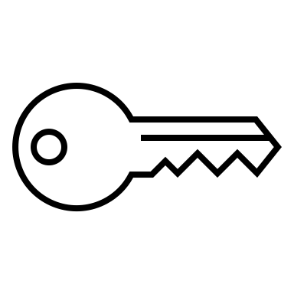
Encryption
Have the key try to open the safe and then
Bounce off. When talking about changing text
To ciphertext, show a regular series of words
On the paper and then have them swirl around
In a colorful pattern and then end up with a
Bunch of random characters that don’t make
Any sense.
Notes:
<mnu>Encryption
One of the oldest ways of keeping something safe is using a lock and key. If you can’t unlock the safe the valuables are in, you’re not likely to get in. Encryption works in a similar way. It uses a digital “key” to scramble regular data into unreadable ciphertext. This key is actually a mathematical formula that inputs the original data and outputs unreadable data.
Anyone who sees the ciphertext will not be able to get anything useful from it unless they have the key.
If you do have the key, you can turn the ciphertext back into readable plaintext. This is a very common method of keeping private data from prying eyes.

Slide 12


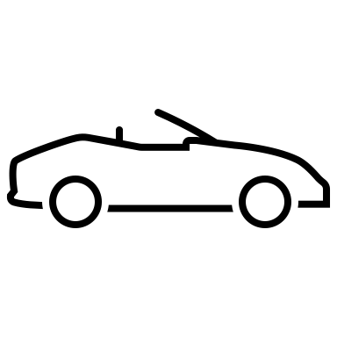
Data Masking
Static
On “hide date” have the mask
Fly over the secure message, hiding it from view.
When talking about dynamic data, have the car
Race off the screen.
Dynamic
This is a secure message.
Notes:
<mnu>Data Masking
Data masking is another way that you can hide data from prying eyes. If you don’t have permission to view a particular piece of data, the data is scrambled with a series of random characters.
You have to different kinds of data masking: static and dynamic.
Static data masking is for data that is stationary. It masks the data permanently, because it is not going anywhere, such as data that is sitting in a database.
Dynamic data masking is done in real time for data that is in motion, being sent from one place to another. It doesn’t touch the original data, only the copy of the data that’s actually in transit.

Slide 13

Data De-Identification
Record 1: Bob Smith 10.5
Record 2: Jenny Kay 11.2
Record 3: Will Fox 22.4
Record 4: Ben Harmon 14.3
Record 5: Sue Stern 24.2
On “you first remove” move the red X over
The names of the people, while still showing
The number values.
Notes:
<mnu>Data De-Identification
When you have a set of data, another way to maintain data privacy is to make sure you use data de-identification.
This means that if you are showing a set of data to the public, you first remove any personally identifiable data, such as a person’s name or email address from the data before displaying it. This helps protect the identities of those who supplied the data in the first place.

Slide 14


Tokenization
On “When data is being sent” show a credit card number being sent to the middle computer.
Then on “tokenizer” show the data change to another random number of the same length.
Then on “The token is sent” show the new number flying over to the safe.
Notes:
<mnu>Tokenization
Another way you can keep data private is through using tokenization. This is a secure way to send sensitive data from one person to another. That’s why it is often used in credit card transactions.
When the data is being sent, a program, called a tokenizer, replaces the sensitive data with non-sensitive data that is the same length and format as the original data. If someone were to intercept the token, it would not tell them anything about the original data.
For example, if you are sending a credit card number, the token will be a number with the same number of digits, but have no relation to the original number. The token is sent to a token vault, where it is then matched up to the proper value.

Slide 15

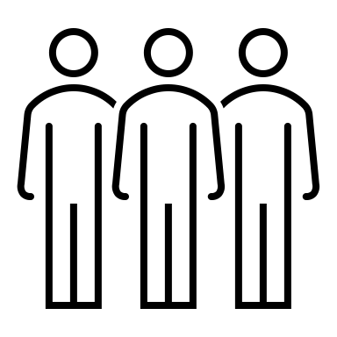

Data Loss Prevention
On “They aren’t going…” have the person on the right move toward the guards and then have to turn back.
Notes:
<mnu>Data Loss Prevention
Picture the guards outside of a military installation. They aren’t going to let just anyone wander into the base because there is information and equipment in there that civilians should not have access to. Anyone who wants to enter base has to show proper credentials.
In much the same way, Data Loss Prevention (DLP) software acts as a guard around an organization’s network. It monitors what data goes in and out of the network and who handles it. It makes sure that only authorized uses can take out sensitive information and stops anyone from taking this information who does not have high enough access privileges. This prevents valuable data from being lost that could damage the company.
DLP software can prevent attacks from outside the organization from hackers, but also can prevent disgruntled company insiders from selling secrets to outsiders.

Slide 16


Digital Rights Management
Start with one CD and then on “Digital piracy” show
The CDs multiplying into a row of identical CDs. Then
On “Digital rights management”, put the shield between
The two.
Notes:
<mnu>Digital Rights Management
Digital media and software are more available than ever, which adds convenience to our lives. With the advantage of accessibly, however, also comes the greater possibility of digital piracy, where those who create media or software are not fairly compensated for their work.
Digital rights management is a data security measure that limits what users can do with particular media or software. For digital media, it can prevent a user from copying, downloading, editing, or forwarding that media. It can include putting a watermark on an image until it is paid for.
For software, DRM can limit the number of times the software can be installed so that the software cannot be widely shared.

Slide 17
Notes:
Now that we’ve taken a look at technical controls, let’s discuss some non-technical controls.

Slide 18



Non-Disclosure Agreements
My lips are
sealed!
Sign an NDA!
Notes:
<mnu>Non-Disclosure Agreements
One very common non-technical is a non-disclosure agreement, sometimes just known as an NDA. This is a legal agreement between parties that one party will not reveal certain information to other parties.
For example, if you work at a software company, you may be asked to sign an NDA when you start working there that you will not tell anyone else about the software you are working on, even if you stop working for that company. This helps keeps that company’s data secure and away from competitors who would like to steal their software. Sometimes an NDA is time-limited, which means that the party only agrees not to speak about something for a certain period of time, such as 5 years after they stop working for a company, after which, they are free to speak freely.
Those who break and NDA can be subject to serious legal repercussions, such as being sue for damages.

Slide 19



Data Minimization
Phone number,
please!
Medical history,
please!
Notes:
<mnu>Data Minimization
Another non-technical control is called data minimization. This is a policy that says that you should only collect just enough data from others in order to fulfill a specific, stated purpose.
If you are running a barbershop, you might ask clients for things like their name and phone number or for their email address if they want to be on your mailing list. But it wouldn’t make sense for your barbershop to ask clients for things like their medical and financial history. This is more information than you need in order to carry out your business purposes. Using data minimization means that less sensitive data is floating around for people to exploit.

Slide 20


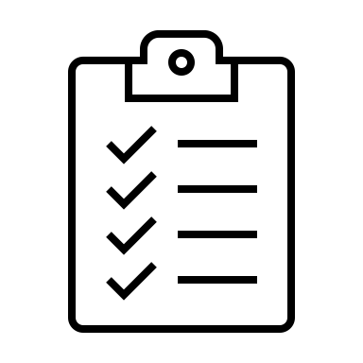



Purpose Limitation
On “If you collect” how the list flying over to the email and put a smiley face
Next to it. On “But then,” show the list flying over to the man with the money
And show a frowning face.
Notes:
<mnu>Purpose Limitation
A related concept is called purpose limitation. This kind of regulation states that data should only be used for the stated purpose for which it was collected.
Let’s go back to the barbershop example. If you collect your client’s names and phone numbers to put them in a client database and you tell them that is all you will use it for, that’s fine. But then, if you turn around and sell these names and phone numbers to a marketing firm so they can use them in advertising, you have violated the principle of purpose limitation, and your clients’ trust.
Part of running a secure, trusted business is making sure your customers know at all times what you will use their personal information for.

Slide 21


Data Retention Standards
On “Legally disposed of”, show the file flying into the
Trashcan.
Expires in
4 years
Notes:
<mnu>Data Retention Standards
Finally, we have what are called data retention standards. These are rules an organization makes about how long they should keep data they have in their possession. There are laws that regulate how long you should keep your clients’ records, and the organization’s data retention standards should take these into account.
For example, if you work at a doctor’s office, it can be important to keep each client’s medical records on files for a number of years so that can referred to later when needed or transferred to a new office if that customer moves.
Records, however, should not usually be kept indefinitely. The more records there are, the higher the chance of having sensitive information leak out. Depending on the kind of records you are dealing with, your organization can set a time limit after which records can be legally disposed of to clear up space and make things less cluttered, and potential more secure.

Slide 22
Summary
Privacy vs. security
Technical vs. non-technical controls
Types of technical controls
Types of non-technical controls
Notes:
<mnu>Summary
That’s it for this lesson. Today, we talked about the difference between privacy and security. We then discussed the difference between technical and non-technical controls. We discussed various kinds of technical controls, and finally we did the same for non-technical controls.

